Slide 1
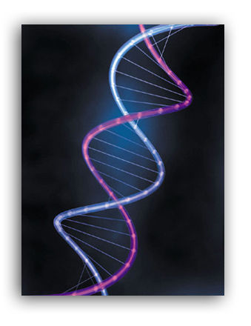
DNA “Deoxyribonucleic acid”

Slide 2
What is DNA?
Hereditary material
“Code of Life” -an organism’s information code for making proteins or traits.
Controls all of the activities of the cell.
Found in the nucleus of EVERY cell in our bodies.

Slide 3
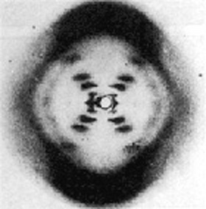
History of DNA
By mid 1800’s, scientists knew that nuclei contained chemicals called nucleic acids.
Rosalind Franklin used x-ray crystallography to discover that DNA is the shape of a twisted ladder called a “double helix”

Slide 4
1953- James Watson and Francis Crick made model of DNA
Won the Nobel Prize

Slide 5
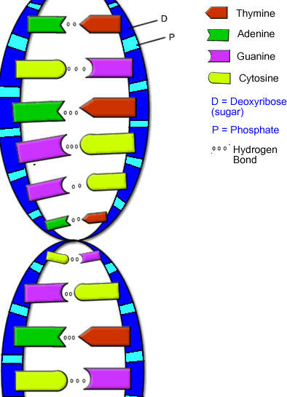
DNA Model
Sides of Ladder: Sugar (deoxyribose) and phosphates
Rungs of ladder: Nitrogen bases (adenine, thymine, guanine, and cytosine)

Slide 6
Chargaff’s Rules
The amount of cytosine always equals the amount of guanine.
The amount of adenine always equals the amount of thymine.
Therefore, they exist as pairs that match up with each other.
A=T
C=G

Slide 7
How is DNA Copied?
By DNA Replication (occurs in interphase)
Steps:
1. Enzymes unwind and separate the two strands.
2. Nitrogen bases floating in the nucleus pair up with original bases on each separated strand.
3. Two new identical DNA strands are formed

Slide 8
